Slide 1
System for Mapping and Predicting Species of Concern
NASA Biodiversity and Ecological Forecasting Team Meeting
23 April 2015
John Olson
Notes:
Intro Team

Slide 2
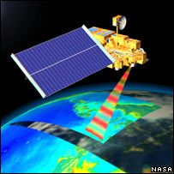
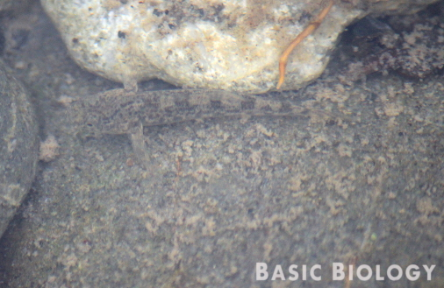
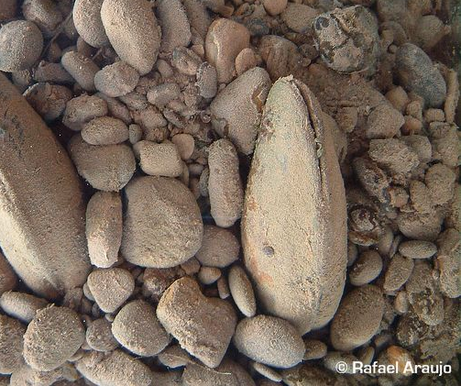
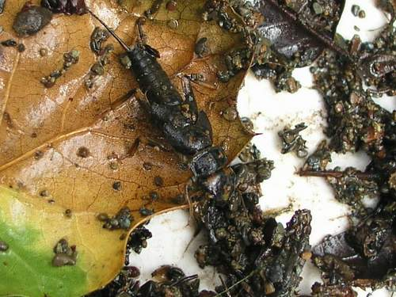
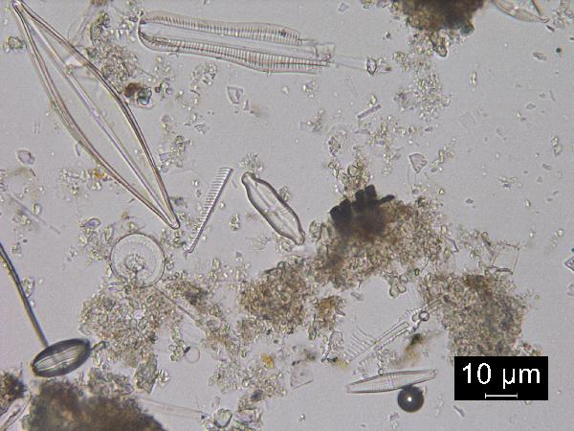
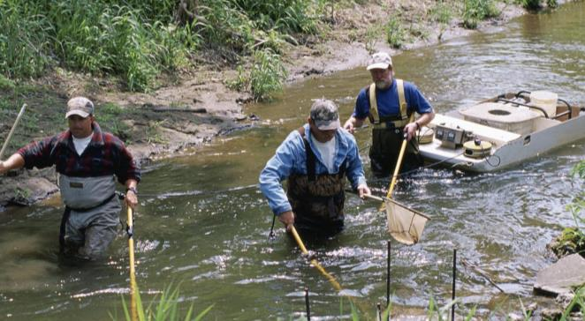
Species Distribution Models are only as good as the data
Species Occurrence ~ f(Environment)
Challenging in streams
Cryptic, little public notice, microscopic
Data collection is time/labor intensive

Slide 3
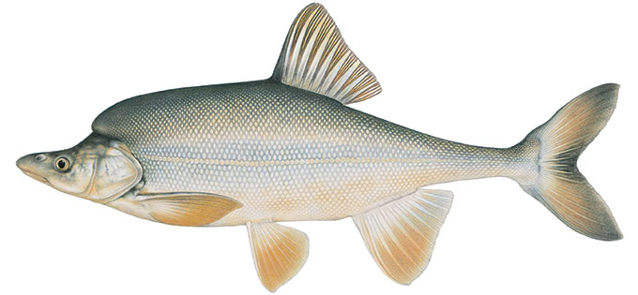

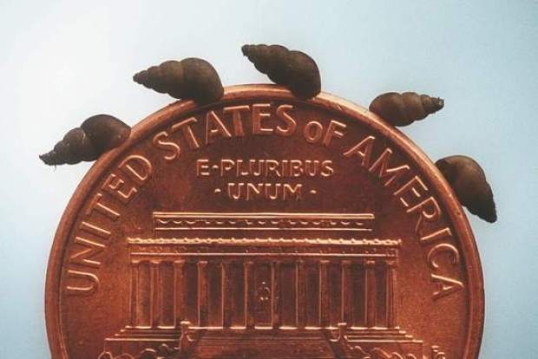
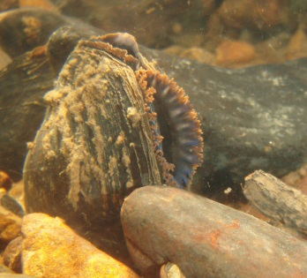
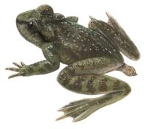
Species Distribution Models are only as good as the data
Species Occurrence ~ f(Environment)
Challenging in streams
Especially important for T&E and early detection of invasives

Slide 4
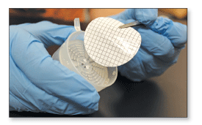
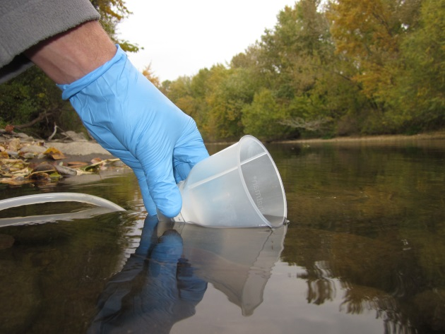

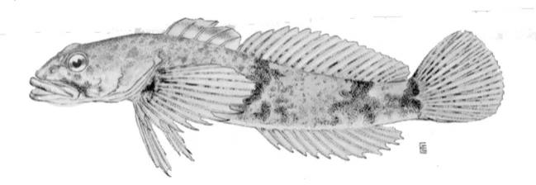

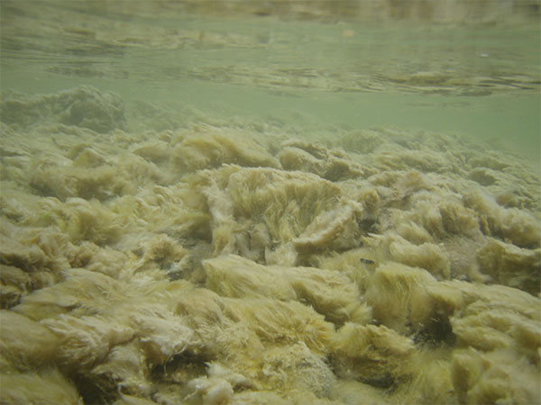

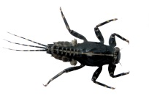



Species Distribution Models are only as good as the data
Species Occurrence ~ f(Environment)
Challenging in streams
Environmental DNA (eDNA)

Slide 5
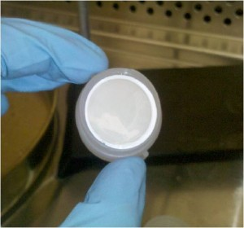
Environmental DNA (eDNA)
Few Known
Species
DNA extraction
Many Unknown
Species
Next Generation Sequencing
Amplification & Detection
Quantitative Polymerase Chain Reaction (qPCR)
  Provides estimate of amount of eDNA in sample
  < 30 min, <$30/sample (known primer/probes)
  Applied to ID’ing crowd sourced samples

Slide 6
Objective:
Predict occurrences of freshwater Species of Concern
Reach level predictions over entire regions to support management
SDM using eDNA & remote sensing data

Slide 7
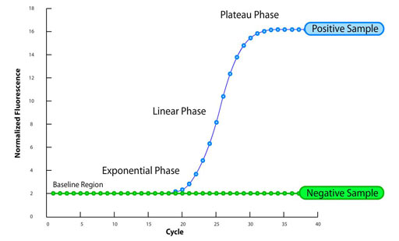
How do we measure when they are so hard to find?
Amplification & Detection
Quantitative PCR (qPCR)
Primers
Fluorophores
Probes
Denaturation – Annealing Cycle

Slide 8
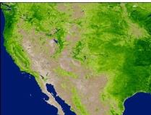
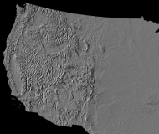
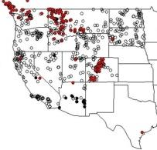
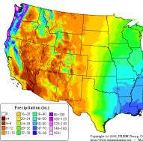
System for Mapping and Predicting Species of Concern (SMAP-SOC)
Crowd Sourced Samples
eDNA
Satellite
Genetic Identification
Predicted occurrences
Species Distribution Models
Current Distribution
Existing Biological Data
Map
Notes:
Address how the science and technology demonstrated in the project is proven and appropriate for the application
All of the technical risks in phase 1 were overcome, met our objective.
Our approach was to
1. Develop data on current distributions for using genetically IDed eDNA and crowd sourced biologic samples combined with existing data
!!! Developed method for crowd sourcing biologic samples for genetic ID
!!! eDNA proved to be cheaper and more effective than traditional techniques - > 80% detection rate
2. Use these data to build SDMs to predict spp occurrences from Earth Obs & water chemistry model predictions
!!! SDMs built with temporally specific Earth Obs captured some of interannual variation, providing better predictions
3. To predict probabilities of a spp occurrence at each stream reach
!!! Successfully applied new technique for extracting watershed information for all reaches in region

Slide 9
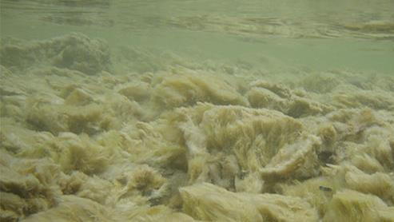
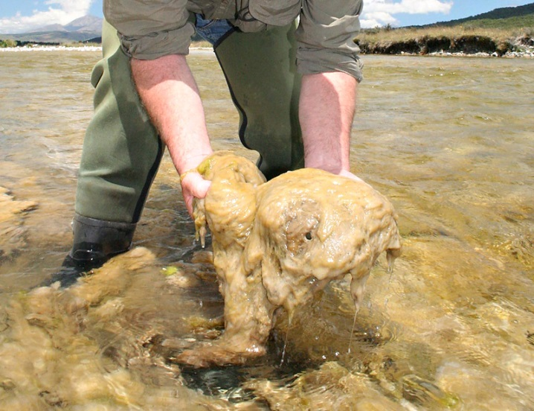
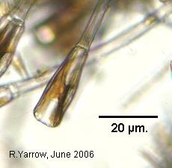
Feasibility Study - Demonstration Species
Didymosphenia geminata (“Didymo” or Rock Snot)
A native invasive
Emerging management concern
Blooms associated with low P
Difficult to detect if not in bloom
DNA probes and primers already available
Previously modeled

Slide 10
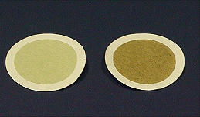
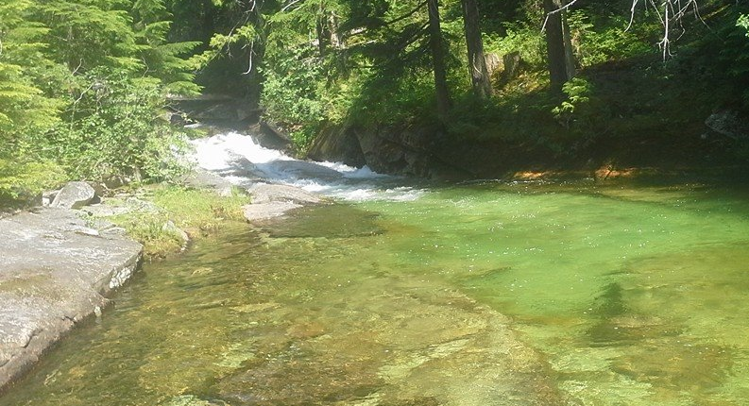
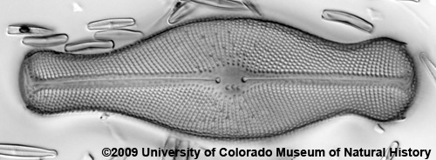
Feasibility Study – eDNA
Sampled until filter clogged, standardized counts by volume
Tested fast & slow habitat samples – slow more sensitive
  80% detection probability with 1 sample, 96% with 2 samples
  50% detection rate with microscope

Slide 11
Feasibility Study - Data
Data
976 Traditional
(but only 637 with dates)
8% presences
70 eDNA sites
5% Validation
Existing Biological Data

Slide 12
Feasibility Study - Models
Species Distribution Models
Model fit assessed using external validation data
Response Data | Sensitivity (% True +) | Specificity (% True -) | AUC | CCR | # of predictors
MaxEnt Models
Static | 0.86 | 0.95 | 0.94 | 0.93 | 15
Temporal | 1.00 | 1.00 | 1.00 | 1.00 | 14
eDNA | 0.93 | 0.62 | 0.77 | 0.70 | 8
Response Data | Sensitivity (% True +) | Specificity (% True -) | AUC | CCR | # of predictors
MaxEnt Models
Static | 0.86 | 0.95 | 0.94 | 0.93 | 15
Temporal | 1.00 | 1.00 | 1.00 | 1.00 | 14
eDNA | 0.93 | 0.62 | 0.77 | 0.70 | 8
eDNA data can produce effective models

Slide 13
Feasibility Study - Models
 | Elevation Std Dev | MODIS ET | Rock % S | MODIS Potential ET
Imp. | 16.4 | 13.8 | 13 | 11.5
Predicted Value
Temporal Model
 | Hydraulic Conductivity | Water-body Area | Soil Bulk Density | % Deciduous | 3 Month Land Temp
Imp. | 10.2 | 8.4 | 5.1 | 3.8 | 3.6
Predicted Value
Importance = % decrease in AUC when the predictor is permuted
Didymo occurrence more likely in wet years

Slide 14
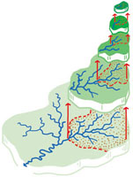
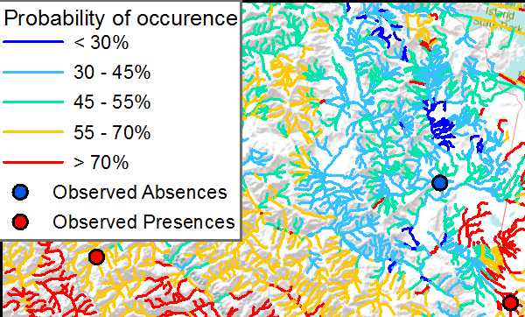
Feasibility Study - Application
Usefulness of Output
Easy to use
Easy to interpret
Watershed Accumulation Tool
Notes:
Assess the feasibility-phase benefits to the end user and how you measure them -
Phase 1 product accurately predicts Dg probability of occurrence, and is easy for managers to use.
Are the predictions useful to managers?
Accurate? Yes > 93% (up to 70% with just eDNA data)
Extent and resolution needed for site level decisions at regional scales.
Is the output easy for decision makers to use?
Ease of use - output is vector GIS data, compact, easily queried, overlain and displayed
Interpretability – BLM managers provided feedback that this format was easily interpretable, and preferred.

Slide 15
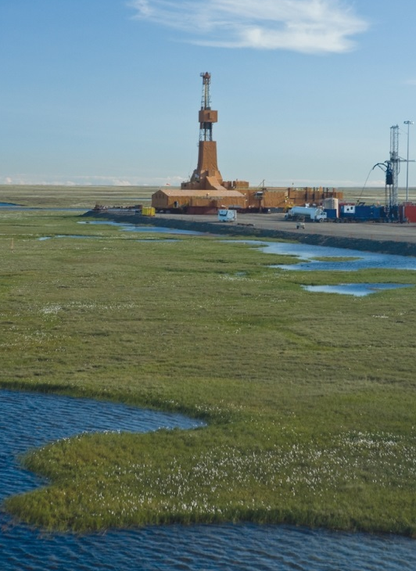
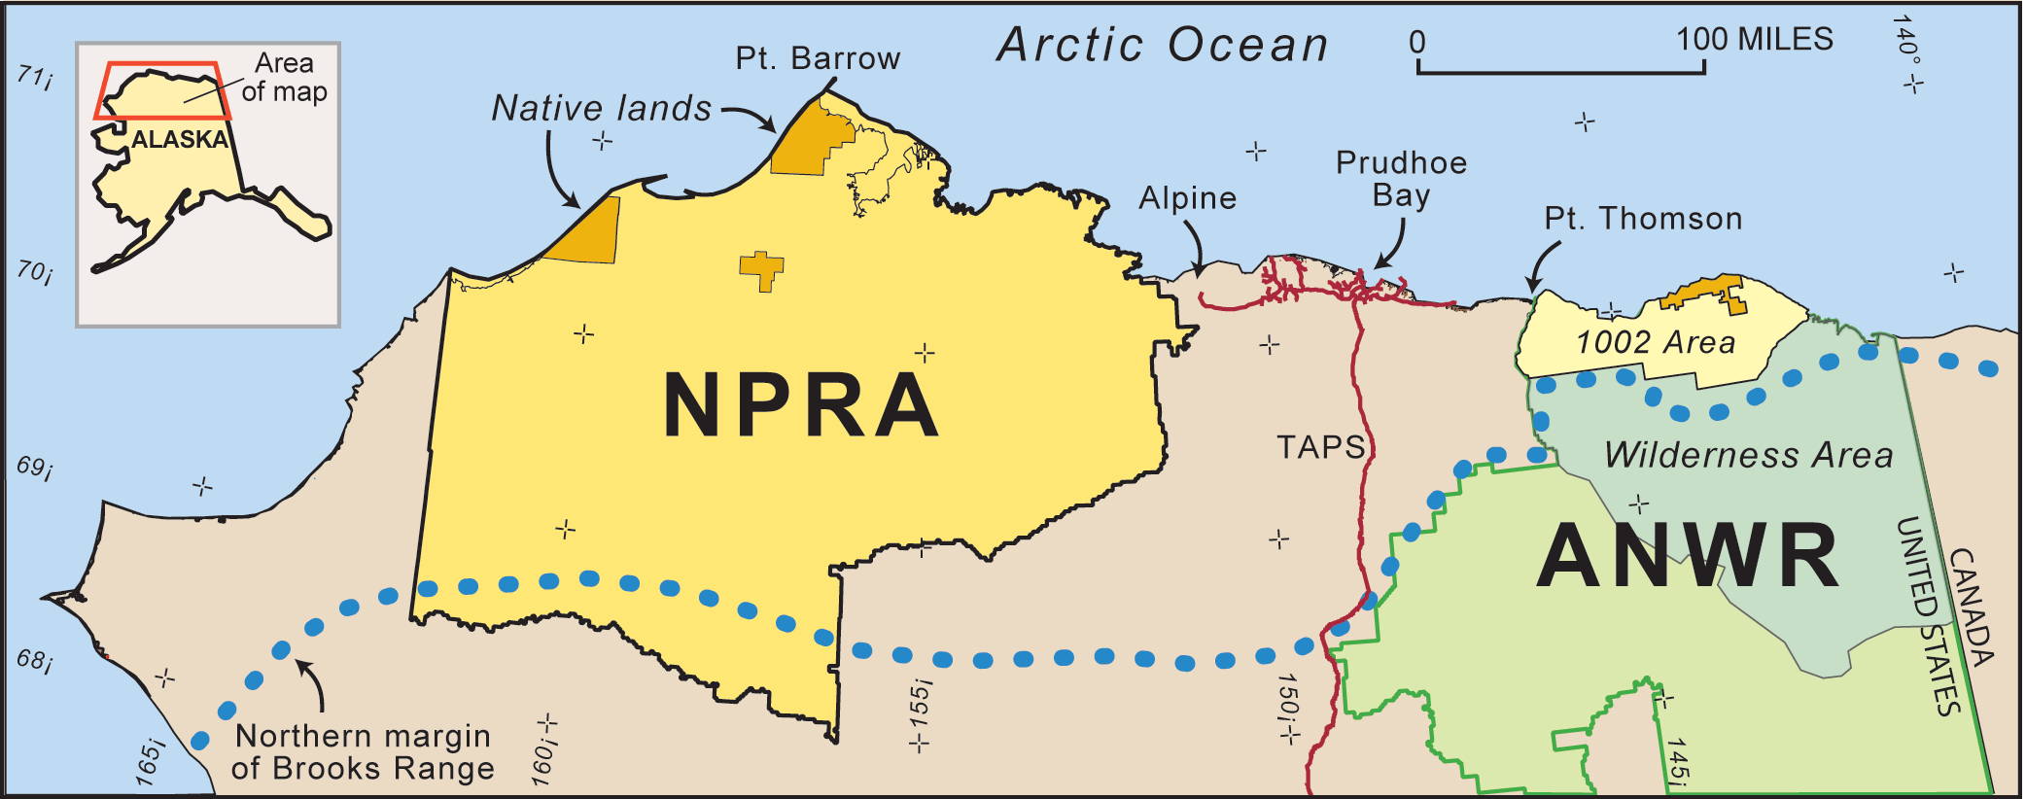
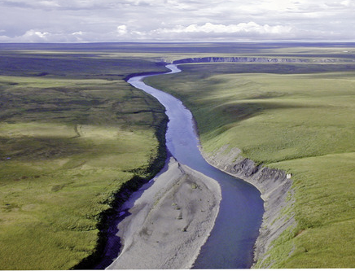
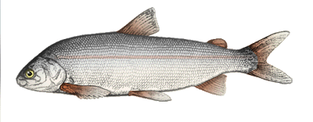
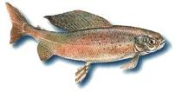
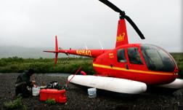

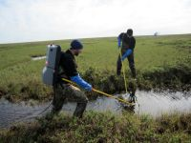



Next Steps
National Petroleum Reserve - Alaska
23 million acres
1000s of miles of streams
Being rapidly developed
Broad Whitefish
Arctic Grayling
Least Cisco
Burbot
Humpback Whitefish
N. Pike
Notes:
What are the strengths and weaknesses of your approach to develop and transfer the application into sustained use?
Describe steps to develop, test and validate the application
Address plans to transition and integrate the application into the end user decision support system
3 steps to fully develop application
Expand number of species to include 5 fish spp, apply to AK north slope where BLM faces challenges assessing spp distros in area rapidly developing
Advantage– more useful tool, in more useful place
Risks – Risk of developing new genetic markers and increased difficulties in collecting samples in AK,
BUT both mitigated by leveraging previous work. eDNA already sampled and sequenced for some places in AK by NPS, so both genetic data and samples available, + data from traditional sampling
Add Earth Observations – Needed to model new species in new environment, but presents little risk - some SDMs already developed successfully for North Slope fish using estimates of total freeze by SAR
Test predictions using external validation data, same as Phase 1
Develop interface
Advantage – take advantage of DRI’s experience in building & hosting interfaces
Risks – BLM’s requirement not fully defined, so will use a iterative development approach to ensure final product fully supports BLM’s decision process.

Slide 16






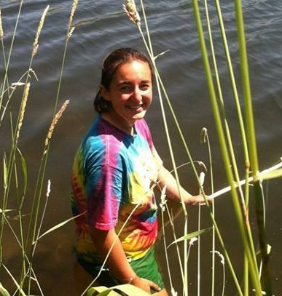
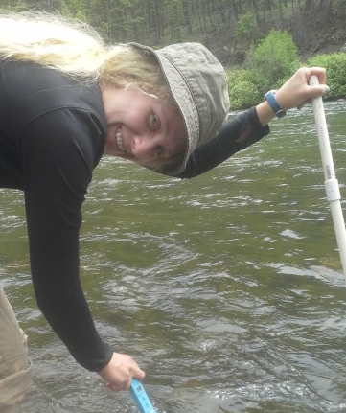
Thanks to
NASA Applied Science Program
Maki Endowment
Chuck Hawkins
Hannah Strobel
Karen Mock
Torrey Rodgers
Marlee Labroo
Notes:
Intro Team

Slide 17
Questions

Slide 18
Feasibility Study
Satellite
Map
64 Candidate environmental predictors
Factor | # predictors | Source
Topography | 7 | National Elevation Dataset
Long-term Climate | 11 | PRISM Model
Temperature | 3 | MODIS
ET/PET | 4 | MODIS
Hydrology | 4 | USGS & NHD
Geology | 12 | Olson & Hawkins 2012
Soils | 8 | STATSGO
Atmospheric Dep | 6 | National Atm Deposition Prgm
Vegetation | 9 | MODIS & Landsat

Slide 19
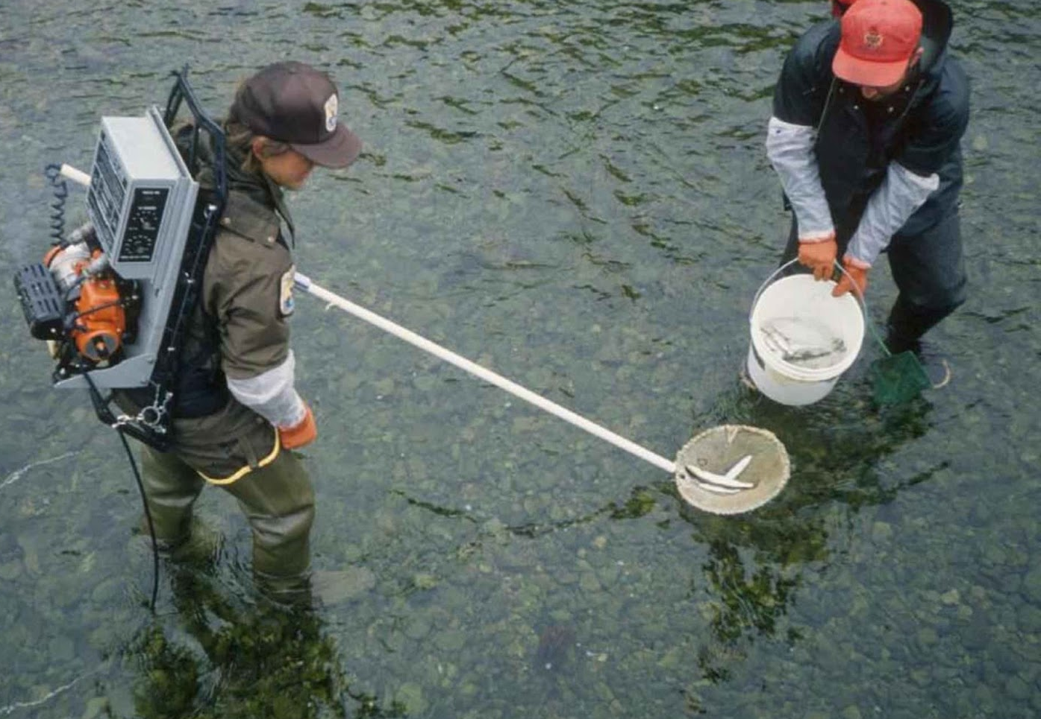
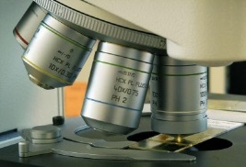
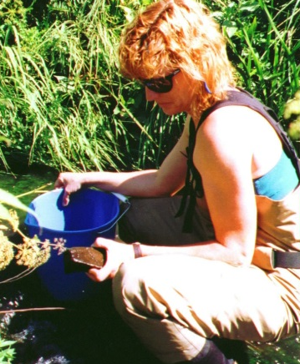
Freshwater fish, invertebrates, & algae are often difficult to detect:
Small
Cryptic
Rare
Current sampling techniques:
Low detection rates (< 50%)
Time and resource intensive

Slide 20




Environmental DNA assessed using qPCR:
Detection rates 80-96%
Faster & cheaper sampling
(< 30 min, <$30/sample)
More and better occurrence data
Robust relationships to NASA data
Resulting in reliable predictions
MaxEnt diatom model using both eDNA and traditional data 93-100% correct classification rates

